Slide 1
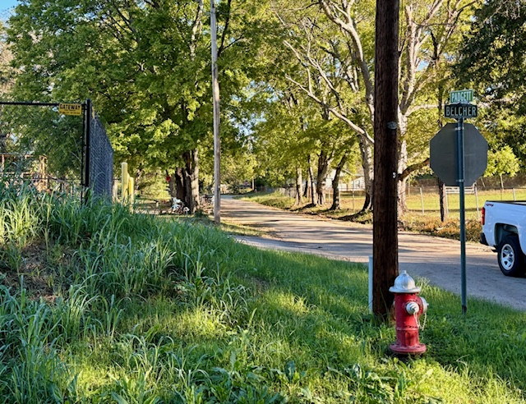
Belcher & Padgett
South End

Slide 2
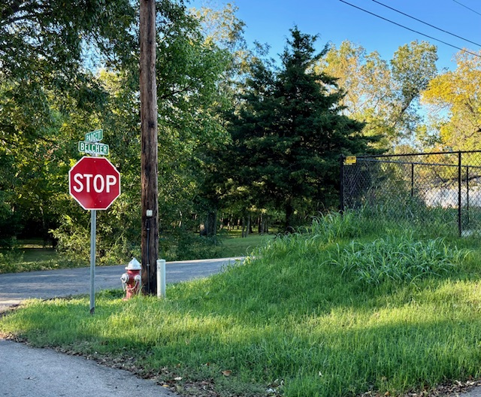
Belcher & Padgett
South End

Slide 3
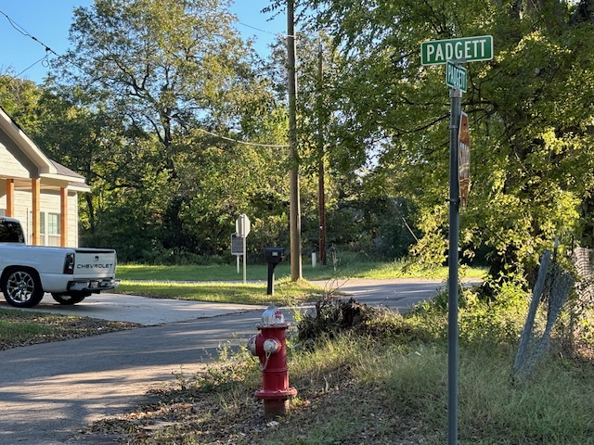
North Padgett toward Krause St.

Slide 4
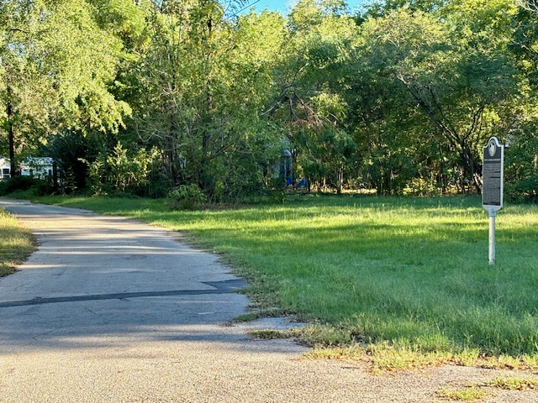
North End
Padgett & Krause
(Bar 20)

Slide 5
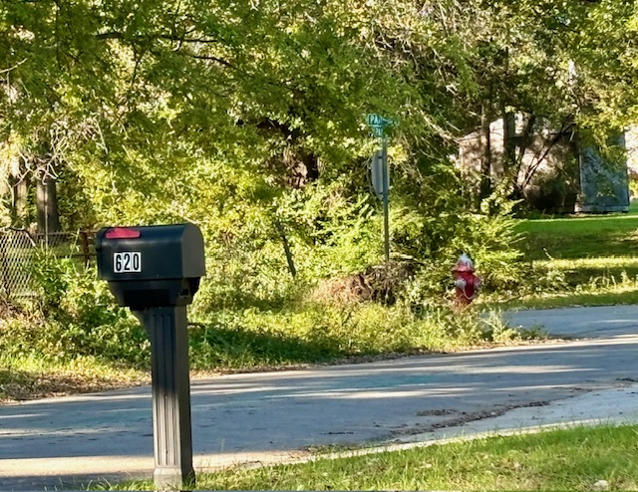
Padgett & Padgett

Slide 6
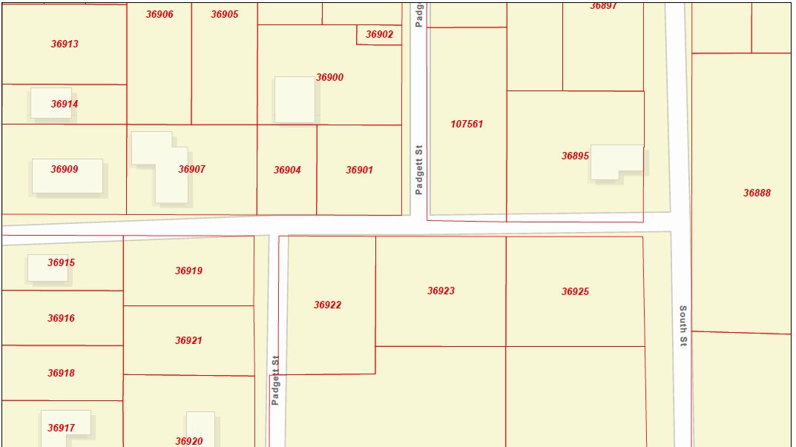
North & South Padgett renamed to Tuck Drive during the October 23, 2023 meeting
Tuck Drive
Padgett
Tuck Drive

